Slide 1
Amazon Web Services Deep-Dive

Slide 2
What is AWS?
Cloud Services together make up cloud computing platform
Compute
Storage
Databases
Caching
Messaging
Networking
Monitoring
Content Delivery
Deployment & Management
Payments & Billing

Slide 3
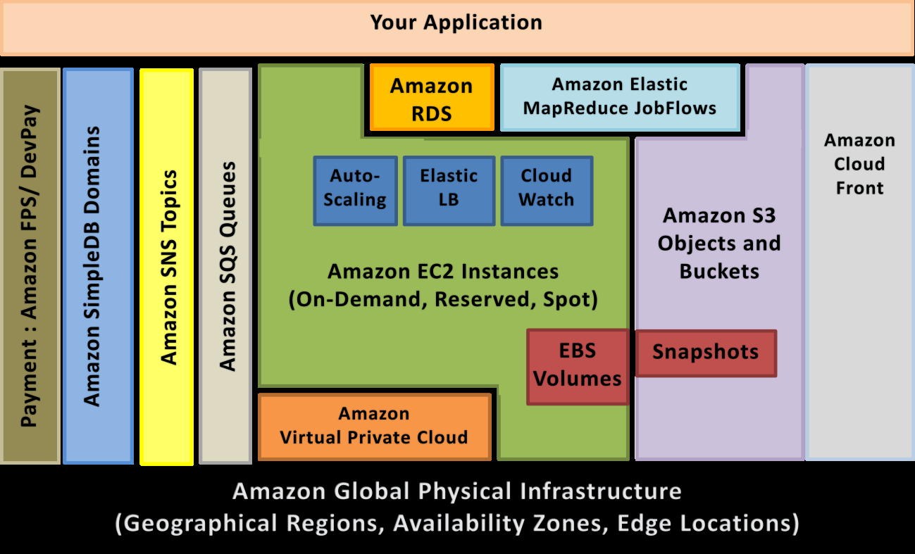
Various AWS Services

Slide 4
About Services - 1
Amazon’s web services scale as and when needed
Completely pay as you go
SOAP and REST interfaces will be available
All features have a comprehensive web services API
Pricing is complicated & the pricing calculator more so!
For example, $0.10 per 1 million IO requests
Amazon cloud is available at 6 different regions
2 in US, 1 in Europe, 1 in Singapore, 1 in Japan, 1 US GovCloud
Regions are priced differently depending on scale, local taxes and other factors
Regions
Availability Zones

Slide 5
About Services - 2
Libraries for popular languages like Java, .Net, Perl, RoR are available
Backed by SLAs(Service Level Agreement) of around 99.99-99.99999% uptime depending on the service
And most importantly:
All data transfer out of Amazon cloud is charged
Around $0.10-$0.19/GB depending on volume & geo
As volume increases price decreases starting from about 10TB
Data transfer across availability zones is charged

Slide 6
Elastic Compute Cloud (EC2)
Resizable compute capacity – scale up or down in minutes
You can choose compute units(cores) and memory as per your needs
Pricing starts from $0.03 per hour for the smallest instance
Flexibility
Variety of OS’s are available: Linux, Windows, OpenSolaris including distributions
Softwares: IBM, MS SQL, JBoss, Hadoop, Oracle, MySQL
Pre-packaged applications like Oracle, SQL, media servers, LAMP, etc. available to choose from
Licensing becomes pay as you go as well!

Slide 7
Elastic Compute Cloud (EC2)
Instance Types
On-demand: Pay by the hour, no long term commitments
Reserved: Book capacity for 1-3 years & get 30-50% reduction
Spot: Bid on unused EC2 capacity. Marketplace for compute capacity!
Instance Sizes
Types: Standard, Micro, High Memory, High CPU, HPC
Memory: 613MB – 68.4 GB
CPU: 1 ECU – 33.5 ECUs
Storage can be ephemeralfs
Amazon Machine Image (AMI)
Select from pre-configured AMIs or create your own

Slide 8
Important Concepts
Amazon Elastic Block Store (EBS)
Persistent storage for Amazon EC2 instances
Independent Volumes that can be attached/detached to instances
EBS backed instances are persistent & can be shut-down & started
Elastic IP Addresses
Static IP addresses for you account to use for your dynamic cloud
Map, re-map Elastic IPs to instances on the fly – no need for DNS changes
Security Groups
Firewall for your EC2 environment
Each instance is started in some security group which enforces the open or closed ports for that instance

Slide 9
Amazon Simple Storage Service - 1
Storage for the internet – HTTP scalable storage
Safe storage – 3 copies, offsite backup as well
99.999999999% durability and 99.99% availability
Each file can be accessed as a URL
http://<bucket>.s3.amazonaws.com/<object>
Can be easily embedded into web pages for delivery through S3
Read, write and delete objects upto 5TB
Modification not allowed
Not like your filesystem
Folder => bucket
File => Object
No block based access

Slide 10
Amazon Simple Storage Service - 2
Data is stored as-is, application needs to encrypt or compress
Authentication is supported for objects and buckets
Objects can be versioned
Integrated with CDN
BitTorrent protocol interface available for high-scale distribution
Media streaming support
AWS Import/Export can be used for large datasets to Fedex disks
Pricing tiers for storage and bandwidth usage
It stores 449 billion objects today!

Slide 11
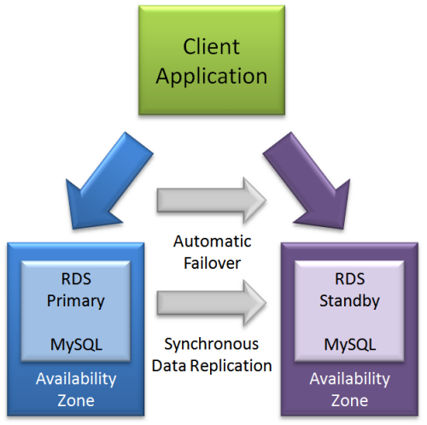
Amazon Relational Database Service
Manages MySQL or Oracle database in the cloud!
AWS provides the patching, backups, recovery, redundancy
Provision capacity or storage on the fly with no downtime
Monitoring of database instances and connections
Replication
Multi-AZ deployments
Read replicas: Scale out for read
heavy applications
Easily migrate existing databases
to the cloud

Slide 12
Amazon SimpleDB
Database as a cloud web service
Scalable non-relational datastore
Create & manages multiple geographically distributed replicas for availability and durability
Simple Data Model: Domains, Items, Attributes, Values
Consistency Options
Eventually consistent reads: Optimize read performance but you may not get latest written data, some time lag
Consistent reads
Provides indexing & query service

Slide 13
CloudFront (CDN)
Integrated, scalable, distributed Content Delivery Network
Delivers your static and streaming content from global network of edge locations.
Improves performance and reduces load on web servers
Integrated with S3 and EC2
Both can be used as origin servers
Pricing depends on edge locations across the world (US, Europe, Hong Kong, Japan) – 19 edge locations today
Private content feature so that your data is not publicly accessible
Real Time Messaging Protocol used for streaming distributions unlike HTTP which is used for other normal distributions

Slide 14
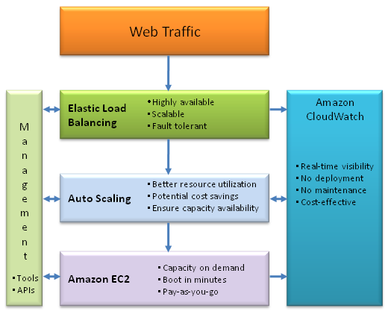

Slide 15
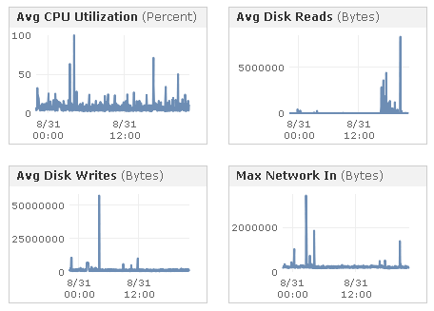
CloudWatch
Monitoring of AWS Cloud resources in real-time
Basic 5-min monitoring – free
Detailed monitoring at 1 minute interval – charged
Create Custom Metrics
Messages in my MQ
Users in my DB
Set alarms & notifications
View graphs and statistics

Slide 16
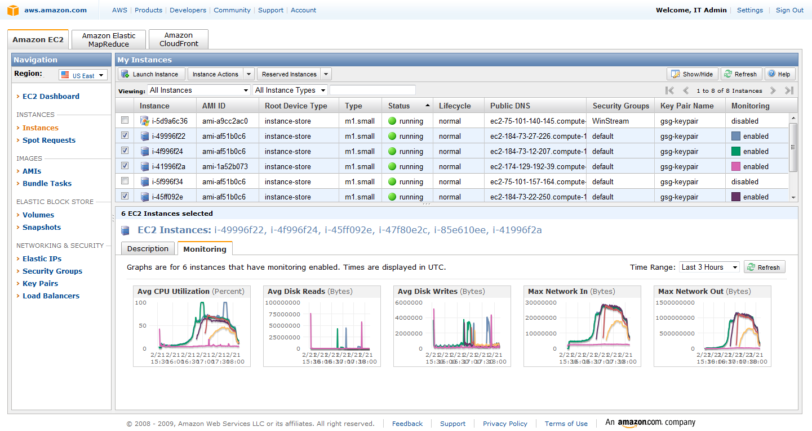
CloudWatch

Slide 17
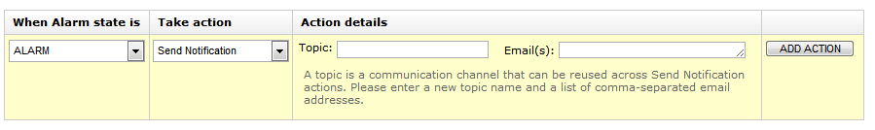
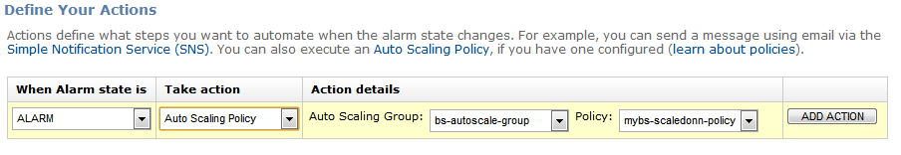
Auto-Scaling
Scale your Amazon EC2 capacity up or down
Triggers
Schedule based
CloudWatch Metrics
Notifications via SNS

Slide 18
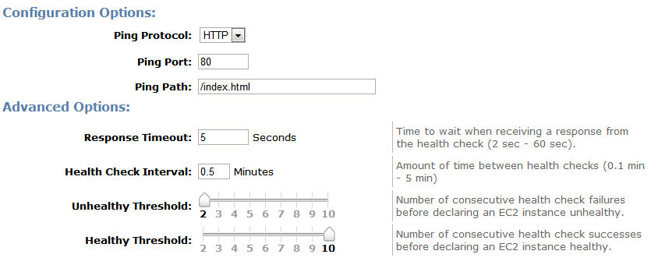
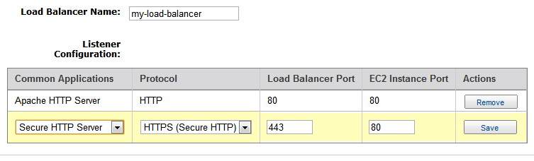
Elastic Load Balancing
Distribute incoming traffic across multiple EC2 instances
Fault tolerance & load balancing
Detects unhealthy instances and reroutes traffic
Can be used across Azs
Supports sticky sessions
SSL & IPv6 support

Slide 19
Simple Queue Service - SQS
Service Oriented Architecture
Loosely coupled
Standard service contracts
Web Services
Enables independent tiers for deployment & management
Messaging / Queue layer – SQS
Web Scale Messaging
Queue 1
Queue 2
Tier A
Tier B

Slide 20
SNS, SES
Simple Notification Service
Create topics and notify applications or people using pubsub
Push mechanism for event driven workflows without polling
Types: HTTP/HTTPS, Email, SQS
Simple Email Service
Bulk email service
Build-in Feedback-loop with notifications of bounce backs, failed/successful attempts, spam complaints
Types: HTTP/HTTPS, Email, SQS

Slide 21
Elastic Mapreduce
Hosted Hadoop Framework
Manages job flows & provisioning of all infrastructure
AWS Console to create & manage workflows
Supports custom jars, Hive, Pig, streaming & processing in multiple languages/stacks
Debug & profile jobs
Run across geographies
Data processing, analytics
Scalable Managed MapReduce Platform
Let us see a demo of a Elastic Map-Reduce run….

Slide 22
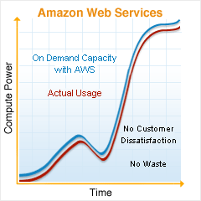
AWS Economics
EC2 Cost Comparison Calculator
Compare costs of own datacenter, colocation & EC2
Using Amazon’s Monthly Cost Calculator
http://aws.amazon.com/calculator

